Slide 1



Welcome to Year 4
Please click on the sound symbol to listen to the voiceover notes that accompany the slides. Thank you!

Slide 2
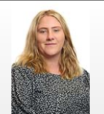

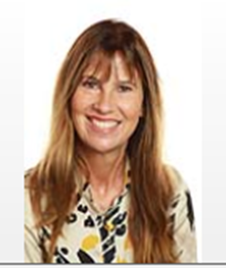
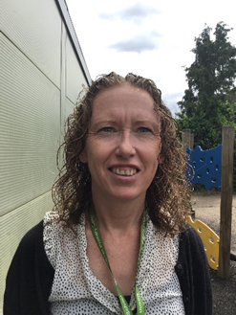
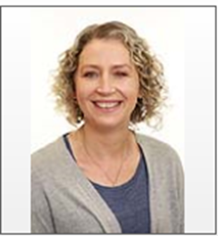
Adults in 4P
Teacher:
Miss Protts
Support Staff:
Mrs Marshall Mrs Ryan
Mrs Arthur

Slide 3
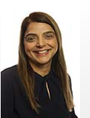
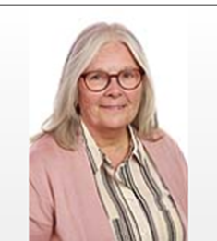
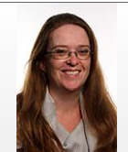
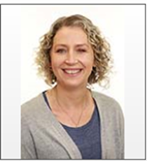
Adults in 4K
Teacher:
Mrs Kaur
Support Staff:
Mrs Ricks Mrs Cheeseman
Mrs Arthur

Slide 4
Uniform
Children should be proud of their school uniform. Please see the school website for our uniform policy for KS2, e.g. the children should wear a white shirt and a school tie.
PE Kit on Friday.
During the winter children need to have black tracksuit bottoms, a jumper and trainers as part of their PE kit
Swimming will start in the Spring term
Ensure earrings are out on PE days. If your child is unable to remove their own earrings, they will not be allowed to take part in PE.

Slide 5
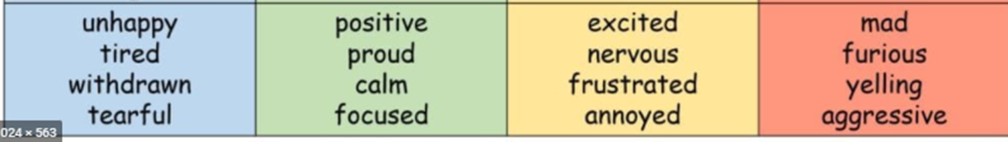
Year 4 Curriculum
Cross curricular learning opportunities
Zones of regulations
Stay on Green
5Rs
Autumn Term - Our World and Environment, Vikings
Spring Term – A study of Africa and Ancient Egypt
Summer Term – A study of Greece and South America

Slide 6
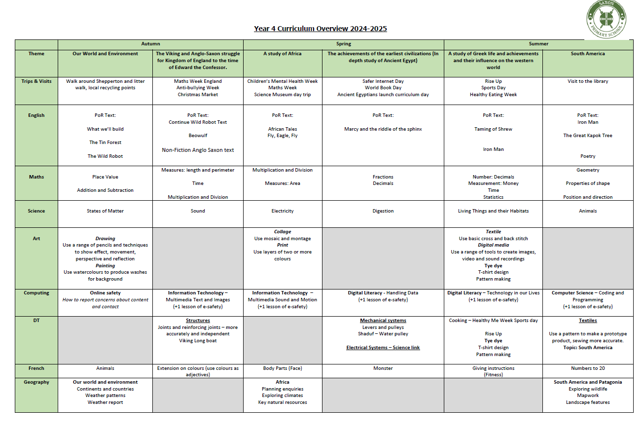

Slide 7
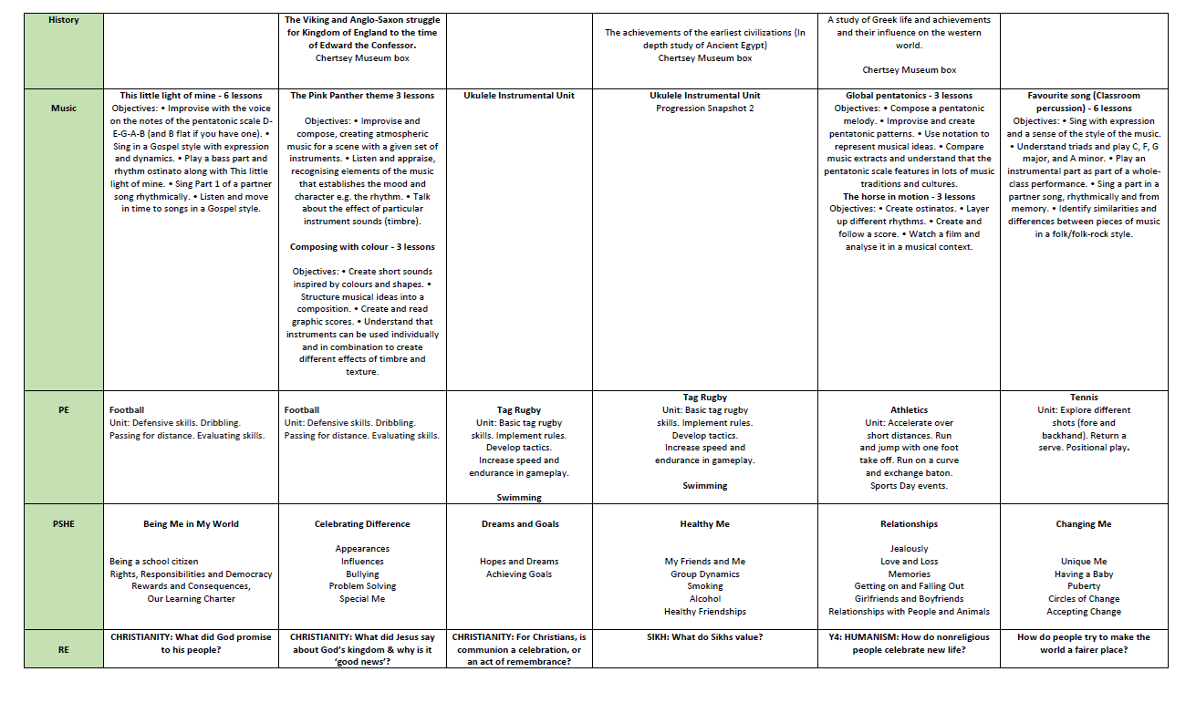

Slide 8
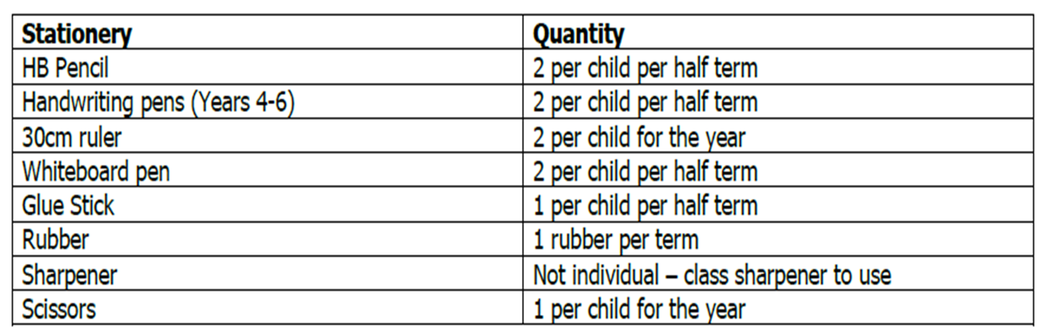
Stationery
Teachers will be monitoring how much each child uses so that we can continue to ensure we do not overspend on stationery. The table below is an example of what each child will receive.

Slide 9
Trips
We will be doing a local visit walk to support our geography and science learning and we are working on organising another trip for the Spring term.
Ancient Egyptian Curriculum day – Spring term
Year 4 residential – Summer term to be confirmed

Slide 10
Home Learning Expectations
Daily Maths Facts are sent out on a Monday and should be returned on a Friday.
Daily reading is expected for 10 minutes a day. Please make a note of your child’s reading in the reading record.
Reading books are sent out on a Friday and are due in on a Wednesday.
CGP English and Maths books are sent on a Thursday and should be handed in on a Tuesday. Answers can be found at the back of the book if you wish to check your child’s learning.
TTRS and maths website

Slide 11

Times Table Check

Slide 12
General Information
Communication
Please speak to us at dismissal or email info.saxon@lumenlearningtrust.co.uk
Please ensure your child brings a piece of fruit or another healthy snack (see our policy) in for their morning snack.
Please see the newsletter for all dates and events.

