Slide 1
Year 5
Curriculum information evening

Slide 2

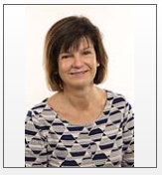
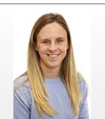
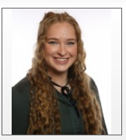
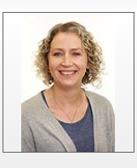
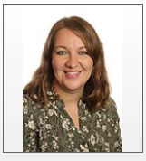
Adults
5P
Teacher: Miss Parsons
Classroom teaching assistant: Mrs Arthur
5W
Teacher: Mrs Williams
Classroom teaching assistant: Mrs Wells
Across Year 5:
Classroom teaching assistant: Mrs Matei

Slide 3
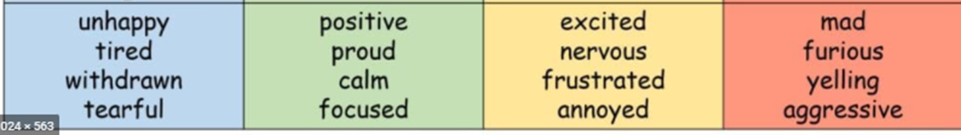
Curriculum
Cross curricular learning opportunities
Zones of regulations
Autumn Term – The Polar Regions
Spring Term – Out of This World (Space) and Rivers.
Summer Term – British History, Tudors and Victorians.
Power of Reading books are used to immerse the children in their English lessons. We also link the topics to our foundation subjects throughout the year.

Slide 4
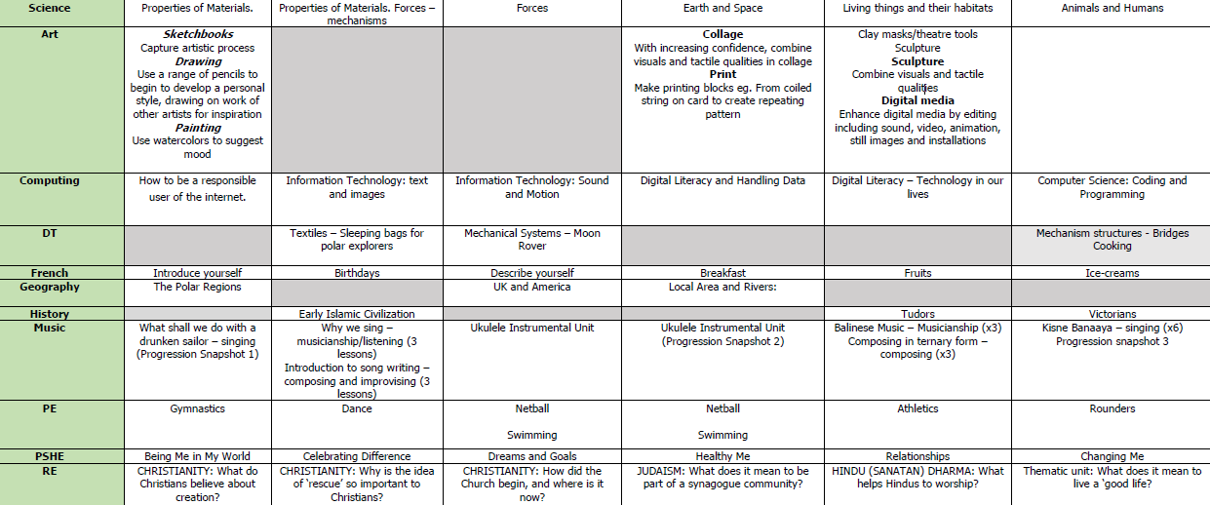

Slide 5
Expectations
Home learning
Reading
Maths facts
Weekly CGP Books
TTRS and maths website.
Forest School takes place this term. You will need to bring in warm and waterproof clothing, including boots/wellies and gloves.

Slide 6
School Uniform
Children should be proud of their school uniform. Please see the school website for our uniform policy for KS2, e.g. the children should wear a white shirt and a school tie.
Uniform: (plain small stud earrings, tie, black school shoes, small green/neutral hair band, green Saxon jumper/cardigan, labelled uniform/bag/water bottle).

Slide 7
PE
Come to school wearing PE kit on PE days. Green shorts/black tracksuit bottoms, white t-shirt, black jumper, trainers.
5P – Mondays
5W – Thursday. A pair of trainers can be left in school for daly movement breaks.
Ensure earrings are out on PE days. If your child is unable to remove their own earrings, they will not be allowed to take part in PE.
Swimming takes place in the Spring Term (January – March).

Slide 8
Stationery and Books
This year, being responsible and respectful to our classroom, and wider school, environment is a key focus. Children are encouraged to take care of their stationary and the presentation in all books. This includes ensuring homework is handed in promptly and all reading and library books are returned.
Trips: Bowles
Friday 21st – Sunday 23rd March.
More information in the upcoming meeting – date TBC.

Slide 9
Thank you!
We are looking forward to a wonderful year of fun learning!
At any point, please speak to us at dismissal or email info.saxon@lumenlearningtrust.co.uk.

